Slide 1

Extracting Student Survey Data using OpenAI's LLM
Dinesh Periyasamy (G23AI2002)
PGDDE, IIT-Jodhpur

Slide 2
Introduction
CONTENT
Overview of extracting and analyzing student survey data
Importance of understanding student preferences
Goals: Extract information, recommend restaurants, store data for analysis

Slide 3
Tools and Framework
OpenAI Models: For extracting and analyzing data
Chat Completion API: Interacting with OpenAI models
Function Calling in OpenAI: Optional advanced functionality
Jupyter Notebook: For interactive coding and visualization
Python: Core programming language
Pandas: For data storage and manipulation
File Handling: For reading and writing survey data

Slide 4
Setting Up the Environment
Installing necessary libraries
Setting up OpenAI API key
!pip install openai pandas requests langchain langchain-community langchain-core langchain-openai
import openai
import requests
import pandas as pd
from langchain.llms import OpenAI
# Set up your OpenAI API key
key = ‘<your API key>'
client = OpenAI(api_key=key)

Slide 5
Reading Survey Data
Reading the survey responses from a text file
# Reading the file
file_path = 'Food Data.txt'
with open(file_path, 'r') as file:
data = file.read()

Slide 6
Extracting Information using OpenAI Models
Define function to extract information from survey response
"fav_Food": {
"type": "string",
"description": "favorite food of the user",
},
"fav_restaurant": {
"type": "string",
"description": "Restaurant name where users prefers to eat",
},
"total_amt": {
"type": "string",
"description": "Amount spent by the user monthly",
}, data = data.replace('\n', '') response = client.chat.completions.create( model="gpt-3.5-turbo", messages=[{"role": "user", "content": data}], tools=user_tools ) response
user_tools = [
{
"type": "function",
"function": {
"name": "user_info",
"description": "Get user information from the text",
"parameters": {
"type": "object",
"properties": {
"name": {
"type": "string",
"description": "name of the user", },

Slide 7
Handling Responses
Extracting and printing responses from the OpenAI model
Handling exceptions
# Print responses and handle exceptions
for i in range(len(response.choices[0].message.tool_calls)):
try:
print(response.choices[0].message.tool_calls[i].function.arguments)
except IndexError:
print("End of tool calls reached.")
break

Slide 8
Storing Data in Pandas DataFrame
Create a DataFrame to store extracted information
# Store the extracted data in a Pandas DataFrame
df = pd.DataFrame(columns=["name", "fav_Food", "fav_restaurant", "total_amt", "city", "suggestion"])
for i in range(len(response.choices[0].message.tool_calls)):
try:
df.loc[i] = response.choices[0].message.tool_calls[i].function.arguments
except IndexError:
break
print(df)

Slide 9
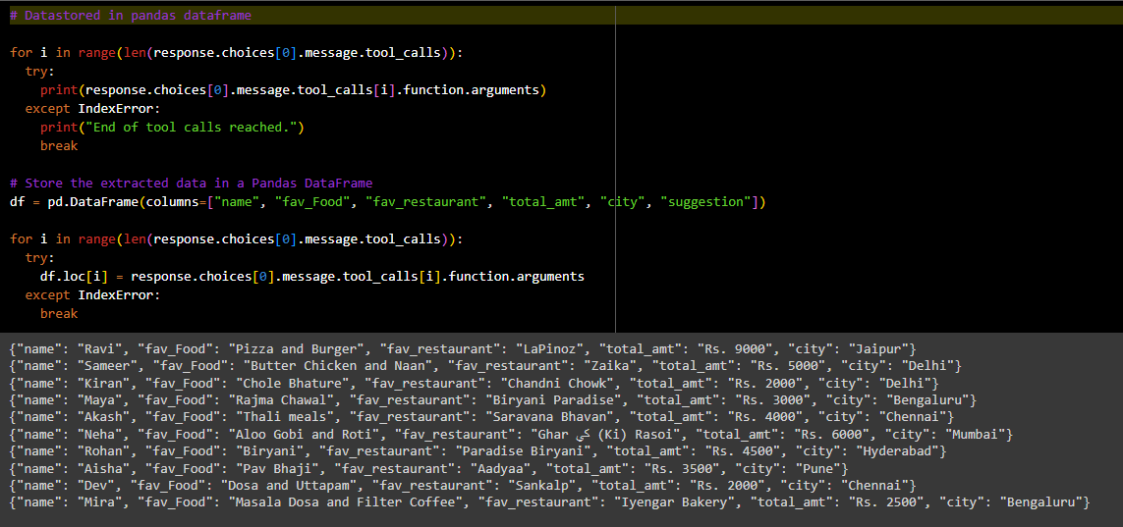
OUTPUT:

Slide 10
Restaurant Recommendations
Using extracted preferences to recommend restaurants
# Restaurant Recommendations
client = OpenAI(api_key=key)
prompt = "Based on student preferences, suggest some restaurants with reason"
print("Based on student preferences, suggest some restaurants")
print(client.invoke(prompt))

Slide 11
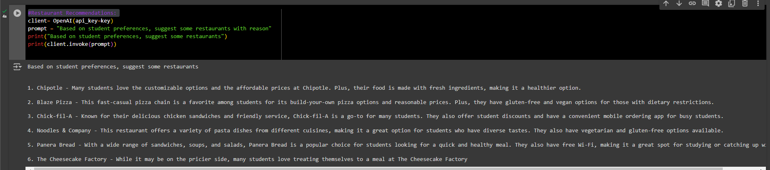
OUTPUT:

Slide 12
Benefits of Using LLM for Data Extraction and Analysis
Efficiency: Automates the process of extracting relevant information from textual data, saving significant time and effort compared to manual extraction.
Accuracy: Minimizes human error in data extraction, providing consistent and reliable results.
Scalability: Easily handles large volumes of survey responses, making it suitable for applications with extensive datasets.
Personalization: Generates personalized recommendations by understanding individual preferences, enhancing user satisfaction.
Flexibility: Adapts to various types of unstructured data, making it applicable across different domains and use cases.

Slide 13
Conclusion
Using large language models (LLMs) for extracting and analyzing student survey data showcases the transformative potential of AI in handling unstructured data. The combination of OpenAI's models, data storage in Pandas, and personalized recommendations provides a powerful toolset for gaining valuable insights from survey data. This approach not only enhances efficiency and accuracy but also opens up new avenues for personalized user experiences and data-driven decision-making.

Slide 14
Thank you!

